Slide 1
DIVIDE AND CONQUER ALGORITHM
ALGORITHM ANALYSIS
<<professor>>
Computer Science Department

Slide 2
INTRODUCTION
An important algorithm design paradigm based on multi-branched recursion.
Works by recursively breaking down a problem into two or more sub-problems of the same (or related) type, until these become simple enough to be solved directly.
The solutions to the sub-problems are then combined to give a solution to the original problem.
Computer Science Department

Slide 3
INTRODUCTION
This technique is the basis of efficient algorithms for all kinds of problems.
The name "divide and conquer" is sometimes applied also to algorithms that reduce each problem to only one sub problem, such as
  the binary search
  Quick sort
  Merge sort
Computer Science Department

Slide 4
BINARY SEARCH TREE
Stores keys in the nodes in a way so that searching, insertion and deletion can be done efficiently.
Binary search tree is either empty or each node N of tree satisfies the following property
  The Key value in the left child is not more than the value of root
  The key value in the right child is more than or identical to the value of root
  All the sub-trees, i.e. left and right sub-trees follow the two rules mention above.
Computer Science Department

Slide 5

EXAMPLE
A binary search tree
Not a binary search tree
Computer Science Department

Slide 6

EXAMPLE
Two binary search trees representing the same Data set:
Computer Science Department

Slide 7
SEARCHING IN BINARY SEARCH TREE
Three steps of searching
  The item which is to be searched is compared with the root node. If the item is equal to the root, then we are done.
  If its less than the root node then we search in the left sub-tree.
  If its more than the root node then we search in the right sub-tree.
The above process will continue till the item is found or you reached end of the tree.
Computer Science Department

Slide 8
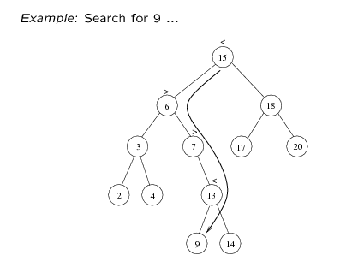
SEARCH FOR 9:
Compare 9:15 (root), go to left subtree
Compare 9:6, go to right subtree
Compare 9:7, go to right subtree
Compare 9:13, go to left subtree
Compare 9:9, found it!
Computer Science Department

Slide 9
QUICK SORT
The divide-and-conquer strategy is used in quicksort. Below the recursion step is described:
Choose a pivot value. It take the value of the middle element as pivot value, but it can be any value, which is in range of sorted values, even if it doesn't present in the array.
Computer Science Department

Slide 10
ALGORITHM
Partition. Rearrange elements in such a way, that all elements which are lesser than the pivot go to the left part of the array and all elements greater than the pivot, go to the right part of the array. Values equal to the pivot can stay in any part of the array. Notice, that array may be divided in non-equal parts.
Computer Science Department

Slide 11
ALGORITHM
Sort both parts. Apply quicksort algorithm recursively to the left and the right parts.
There are two indices i and j and at the very beginning of the partition algorithm i points to the first element in the array and j points to the last one.
Then algorithm moves i forward, until an element with value greater or equal to the pivot is found.
Computer Science Department

Slide 12
ALGORITHM
Index j is moved backward, until an element with value lesser or equal to the pivot is found.
If i ≤ j then they are swapped and i steps to the next position (i + 1), j steps to the previous one (j - 1).
Algorithm stops, when i becomes greater than j.
After partition, all values before i-th element are less or equal than the pivot and all values after j-th element are greater or equal to the pivot.
Computer Science Department

Slide 13
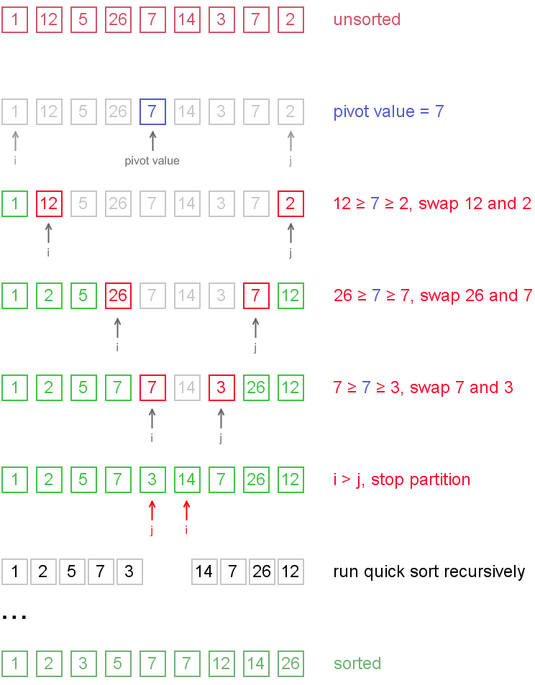
Example

Slide 14
MULTIPLICATION OF LARGE INTEGERS
A = 12345678901357986429
B = 87654321284820912836
C=A*B
Computer Science Department

Slide 15
MULTIPLICATION OF LARGE INTEGERS
Consider the problem of multiplying two (large) n-digit integers represented by arrays of their digits such as:
A = 15678901357986429 B = 4321284820912836
The grade-school algorithm:
a₁ a₂ … a_{n}
b₁ b₂ … b_{n}
(d₁₀) d₁₁d₁₂ … d_{1n}
(d₂₀) d₂₁d₂₂ … d_{2n}
… … … … … … …
(d_{n0}) d_{n1}d_{n2} … d_{nn}
Efficiency: Θ(n²) single-digit multiplications
Computer Science Department

Slide 16
DIVIDE-AND-CONQUER ALGORITHM
A small example: A ∗ B where A = 2135 and B = 4014
A = (21·10² + 35), B = (40 ·10² + 14)
So, A ∗ B = (21 ·10² + 35) ∗ (40 ·10² + 14)
= 21 ∗ 40 ·10⁴ + (21 ∗ 14 + 35 ∗ 40) ·10² + 35 ∗ 14
= 8,569,890
In general, if A = A₁A₂ and B = B₁B₂
(where A and B are n-digit, A₁, A₂, B₁, B₂ are n/2-digit numbers),
A ∗ B = A₁ ∗ B₁·10^{n} + (A₁ ∗ B₂ + A₂ ∗ B₁) ·10^{n/2} + A₂ ∗ B₂
Recurrence for the number of one-digit multiplications M(n):
M(n) = 4M(n/2), M(1) = 1
Solution: M(n) = n²
Computer Science Department

Slide 17
SECOND DIVIDE-AND-CONQUER ALGORITHM
A ∗ B = A₁ ∗ B₁·10^{n} + (A₁ ∗ B₂ + A₂ ∗ B₁) ·10^{n/2} + A₂ ∗ B₂
The idea is to decrease the number of multiplications from 4 to 3:
(A₁ + A₂ ) ∗ (B₁ + B₂ ) = A₁ ∗ B₁ + (A₁ ∗ B₂ + A₂ ∗ B₁) + A₂ ∗ B_{2,}
I.e., (A₁ ∗ B₂ + A₂ ∗ B₁) = (A₁ + A₂ ) ∗ (B₁ + B₂ ) - A₁ ∗ B₁ - A₂ ∗ B_{2,}
which requires only 3 multiplications at the expense of (4-1) extra add/sub.
Recurrence for the number of multiplications M(n):
M(n) = 3M(n/2), M(1) = 1
Solution: M(n) = 3^{log 2n} = n^{log 23} ≈ n^{1.585}
What if we count both multiplications and additions?
Computer Science Department

Slide 18
WHY BOTHER?
Doesn’t hardware provide multiply? It is fast, optimized, and free.
True for numbers that fit in one computer word. But what if numbers are very large.
Cryptography (encryption, digital signatures) uses big number “keys”. Typically 256 to 1024 bits long!
n² multiplication too slow for such large numbers
Karatsuba’s (1962) divide and conquer scheme multiplies two n bit numbers in O(n^{1.59}) steps.
Computer Science Department

Slide 19
KARATSUBA’S ALGORITHM
Let X and Y be two n-bit numbers. Write
X = a b
Y = c d
a,b,c,d are n/2 bit numbers (assume n=2k)
XY = (a2^{n/2} +b) (c2^{n/2} +d)
= ac2^{n} +(ad+bc) 2^{n/2}+bd
Computer Science Department

Slide 20
EXAMPLE
X = 4729 Y=1326
a=47 b=29
c=13 d=26
ac = 47 * 13 = 611
ad = 47 * 26 = 1222
bc = 29 * 13 = 377
bd = 29 * 26 = 754
XY = 6,110,000 + 159,900 + 754
= 6,270,654
KARATSUBA’S ALGORITHM
Let X and Y be two n-bit numbers.
Write
X = a b
Y = c d
a,b,c,d are n/2 bit numbers
(assume n=2k)
XY= (a2^{n/2} +b) (c2^{n/2} +d)
= ac2^{n} +(ad+bc) 2^{n/2}+bd
Computer Science Department

Slide 21
SHORT QUIZ
X = 1026 and Y = 7329
X*Y
KARATSUBA’S ALGORITHM
Let X and Y be two n-bit numbers.
Write
X = a b
Y = c d
a,b,c,d are n/2 bit numbers
(assume n=2k)
XY= (a2^{n/2} +b) (c2^{n/2} +d)
= ac2^{n} +(ad+bc) 2^{n/2}+bd
Computer Science Department

Slide 22
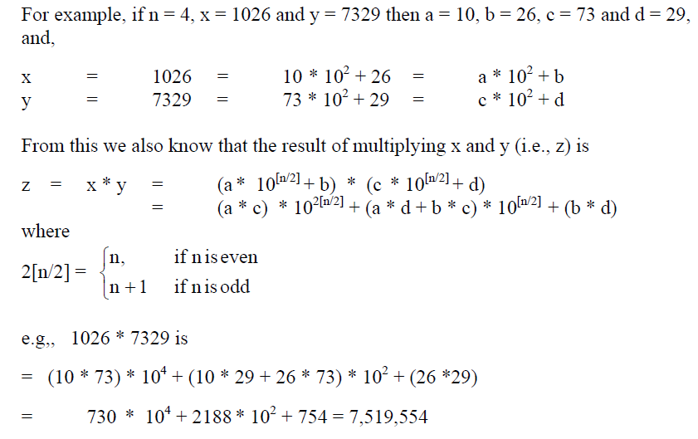
Computer Science Department

Slide 23
CONVENTIONAL MATRIX MULTIPLICATION
Brute-force algorithm
    c₀₀ c₀₁ a₀₀ a₀₁ b₀₀ b₀₁
    = *
    c₁₀ c₁₁ a₁₀ a₁₁ b₁₀ b₁₁
    a₀₀ * b₀₀ + a₀₁ * b₁₀ a₀₀ * b₀₁ + a₀₁ * b₁₁ =
    a₁₀ * b₀₀ + a₁₁ * b₁₀ a₁₀ * b₀₁ + a₁₁ * b₁₁
8 multiplications
Efficiency class in general:  (n³)
4 additions
Computer Science Department

Slide 24
STRASSEN’S MATRIX MULTIPLICATION
Strassen’s algorithm for two 2x2 matrices (1969):
    c₀₀ c₀₁ a₀₀ a₀₁ b₀₀ b₀₁
    = *
    c₁₀ c₁₁ a₁₀ a₁₁ b₁₀ b₁₁
    m₁ + m₄ - m₅ + m₇ m₃ + m₅
    =
    m₂ + m₄ m₁ + m₃ - m₂ + m₆
m₁ = (a₀₀ + a₁₁) * (b₀₀ + b₁₁)
m₂ = (a₁₀ + a₁₁) * b₀₀
m₃ = a₀₀ * (b₀₁ - b₁₁)
m₄ = a₁₁ * (b₁₀ - b₀₀)
m₅ = (a₀₀ + a₀₁) * b₁₁
m₆ = (a₁₀ - a₀₀) * (b₀₀ + b₀₁)
m₇ = (a₀₁ - a₁₁) * (b₁₀ + b₁₁)
7 multiplications
18 additions
Computer Science Department

Slide 25
STRASSEN’S MATRIX MULTIPLICATION
Strassen observed [1969] that the product of two matrices can be computed in general as follows:
    C₀₀ C₀₁ A₀₀ A₀₁ B₀₀ B₀₁
    = *
    C₁₀ C₁₁ A₁₀ A₁₁ B₁₀ B₁₁
    M₁ + M₄ - M₅ + M₇ M₃ + M₅
    M₂ + M₄ M₁ + M₃ - M₂ + M₆
=
Computer Science Department

Slide 26
FORMULAS FOR STRASSEN’S ALGORITHM
M₁ = (A₀₀ + A₁₁) ∗ (B₀₀ + B₁₁)
M₂ = (A₁₀ + A₁₁) ∗ B₀₀
M₃ = A₀₀ ∗ (B₀₁ - B₁₁)
M₄ = A₁₁ ∗ (B₁₀ - B₀₀)
M₅ = (A₀₀ + A₀₁) ∗ B₁₁
M₆ = (A₁₀ - A₀₀) ∗ (B₀₀ + B₀₁)
M₇ = (A₀₁ - A₁₁) ∗ (B₁₀ + B₁₁)
Computer Science Department

Slide 27
CONVEX-HULL PROBLEM
Recall the convex hull is the smallest polygon containing all the points in a set, S, of n points Pi = (x_{i}, y_{i}). The set of vertices defines the polygon and the points of the vertices are found in the original set of points.
Recall the brute force algorithm. Make all possible lines from pairs of points and then check if the rest of the points are all on the same side of the line. How much? There are n(n-1)/2 such lines and then it check withn-2 remaining points. So the cost is cubic.
Computer Science Department

Slide 28
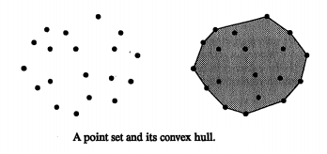
CONVEX-HULL PROBLEM
Computer Science Department

Slide 29

Computer Science Department

